Slide 1
Applied Physics
Unit 3: Optoelectronics
Dr. G. Patrick

Slide 2
Unit 3: Optoelectronics
Radiative transitions: Absorption, Spontaneous and Stimulated emission, Non-radiative transitions: Auger recombination, Surface recombination and recombination at defects, Generation and recombination mechanism in semiconductors, LED and Semiconductor lasers: Device structure, Materials, Characteristics, Semiconductor photo-detectors: PIN and Avalanche detectors and their structure, Materials, Working principle and Characteristics, Solar cell: Structure and Characteristics.

Slide 3
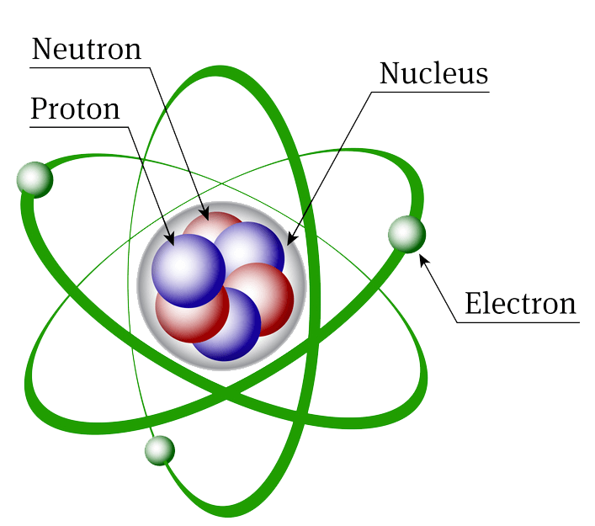
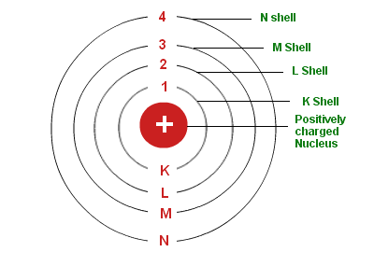
Atomic Structure

Slide 4
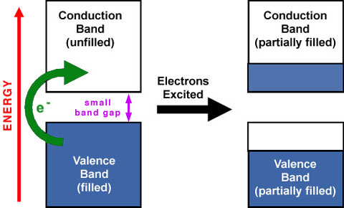
Valence band and conduction band

Slide 5
Generation and Recombination
When one electron leaving the energy level creates a hole, the process is called electron-hole pair generation. Similarly, when an electron from conduction band recombines with a hole in the valence band, the process is called recombination.
Generation and recombination of electron - hole pair essentially require external energies such as optical, electrical or thermal energies. Such processes are mainly between the valence band and the conduction band.

Slide 6
Radiative and Non radiative recombination
Radiative recombination occurs when an electron in conduction band recombines with a hole in the valence band and the excess energy is given out as photon.
Optical process associated with radiative recombination are: Absorption, Spontaneous emission and Stimulated emission.
Non - Radiative recombination occurs when an electron in conduction band recombines with a hole in the valence band and the excess energy is given out as heat.
Non-Radiative recombination process involves: Augur recombination, Surface recombination and recombination at defects.

Slide 7
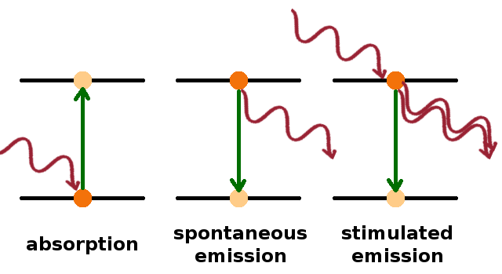
Radiative recombination
Absorption: When at atom absorbs an amount of energy ‘hv’ in the form of photon from the external agency and is excited into the higher energy levels from ground state, then this process is known as absorption.
Spontaneous Emission: When an atom in the excited state emits a photon of energy ‘hv’ coming down to ground state by itself without any external agency, such an emission is called spontaneous emission.
Photons released in spontaneous emission are not coherent.

Slide 8
Radiative recombination
Stimulated Emission: When an atom in the excited state, comes down to ground state with the influence of an external agency(energy), such an emission is called stimulated emission. Two photons of same energy ‘hv’ are emitted.
In the two photons one photon induces the stimulated emission and the second one is released by the transition of atom from higher energy level to lower energy level.
Both the photons are coherent.

Slide 9
Non Radiative transitions
Non - Radiative recombination occurs when an electron in conduction band recombines with a hole in the valence band and the excess energy is given out as heat.
Non-Radiative recombination process involves: Augur recombination, Surface recombination, recombination at defects.

Slide 10
Augur recombination
Augur recombination is of 2 types:
1. One electron from conduction band recombines with a hole in valence band and releases energy. This energy may be taken by another electron in conduction band. The electron that gained energy jumps to higher state and then comes back to the valence band by giving out its energy.
2. One electron from conduction band recombines with a hole in valence band and releases energy. This energy may knock out a electron and create a hole.
Both the processes are non-radiative.

Slide 11
Surface recombination
Recombination at surfaces and interfaces can have a significant impact on the behavior of semiconductor devices. This is because surfaces and interfaces typically contain a large number of recombination centers because of the abrupt termination of the semiconductor crystal, which leaves a large number of electrically active states. In addition, the surfaces and interfaces are more likely to contain impurities since they are exposed during the device fabrication process.

Slide 12
Non Radiative transitions

Slide 13
Generation and Recombination
When sufficient energy in the form of thermal energy or optical illumination is given to the semiconducting material, covalent bonds are broken and a pair of electron and hole is generated.
The electrons are raised from valence band to conduction band. Holes remain in the valence band.
The process of generation can occur only when the energy given to the semiconducting material is greater than its forbidden energy gap.
The electrons move in the conduction band and holes in the valence band. Their motion is a random motion.
The number of electrons is equal to the number of holes.

Slide 14
Generation and Recombination
When an electron in the conduction band collides with other particles, it looses energy and falls to the valence band. In the valence band the electron combines with a hole and in the process energy is released.
Recombination is the process where an electron from the conduction band recombines with a hole in the valence band. This is called band to band recombination and in the process a photon is released.

Slide 15
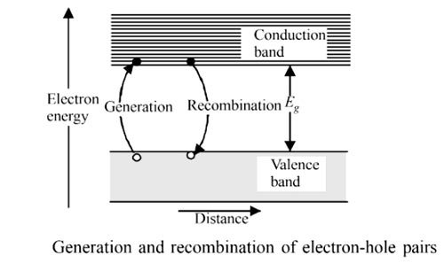
Generation and Recombination
At a steady temperature a dynamic equilibrium exists which balances the two processes of electron-hole pair generation and electron-hole recombination.

Slide 16
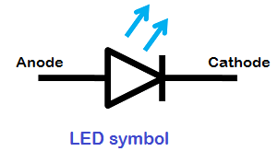
LED: Light emitting diode
Principle: A Light emitting diode (LED) is essentially a p-n junction diode that gives off light when it is forward biased.
The amount of light emitted is directly proportional to the forward current.
The wavelength of the light emitted, and hence the color, depends on the band gap energy of the materials forming the p-n junction.
hν = E_{g}
hc/λ = E_{g}
λ = hc/ E_{g}

Slide 17
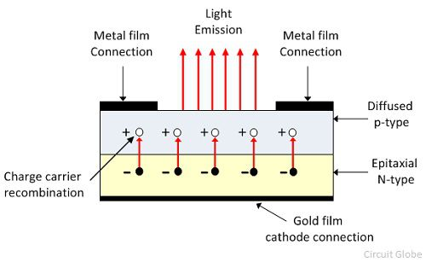
LED: Light emitting diode

Slide 18
LED: Light emitting diode
In a surface emitting LED light is emitted in a direction perpendicular to the p-n junction plane.
An n-type layer is grown on a substrate and a p-type layer is grown on it by the process of diffusion.
The p-layer is made very thin to prevent loss of photons due to absorption in the layer. Metal contact is present on the p-layer such that some part of p-layer will allow photons to escape.

Slide 19
LED: Light emitting diode
Metal contact is present at the bottom for reflecting the photons into the material and to provide electrical contact.
The generated light may suffer total internal reflection at the semiconductor-air interface and hence the device is enclosed in a epoxy resin of suitable refractive index so that the photons escape.

Slide 20
LED: Light emitting diode
Working:
The p-n junction is forward biased.
Electrons from n side get injected to p side.
Hole injection from p side to n side is very less(p side is thin)
Electrons injected into the p-side recombine with the holes which results in spontaneous emission of photons (light). This effect is called injection electroluminescence. These photons should be allowed to escape from the device without being reabsorbed.
The recombination can be classified into the following two kinds
Direct recombination
Indirect recombination

Slide 21
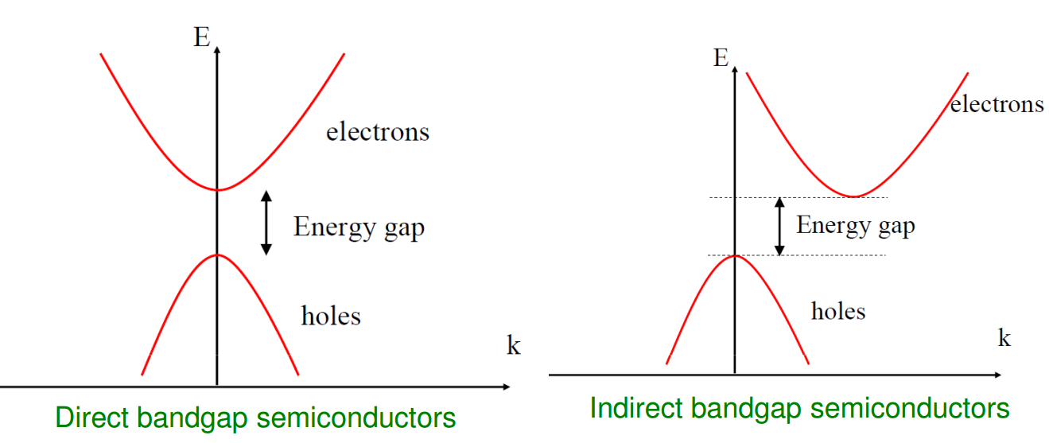
LED: Light emitting diode

Slide 22
LED: Light emitting diode
Direct band gap semiconductor
Indirect band gap semiconductor
In direct band gap materials, the minimum energy of the conduction band occurs at the same value of momentum vector(K) as the maximum energy of the valence band.
The efficiency of transition is good.
GaAs is an example of a direct band-gap material
In in-direct band gap materials, the minimum energy of the conduction band and maximum energy of valence band occur at different values of momentum vector(K).
Due to this difference in momentum, the probability of direct electron-hole recombination is less.
GaP is an example of an indirect band-gap material

Slide 23
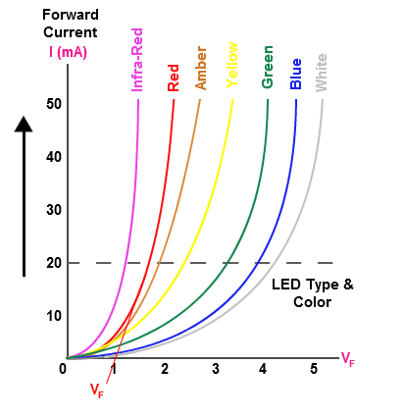
Characteristics of LED
One of the major characteristics of an LED is its colour.
Gallium Arsenide, GaAs emits light in infrared region.
Gallium Arsenide-Phosphide, GaAsP emits red or yellow colour.
Gallium Phosphide, GaP emits red or green colour

Slide 24
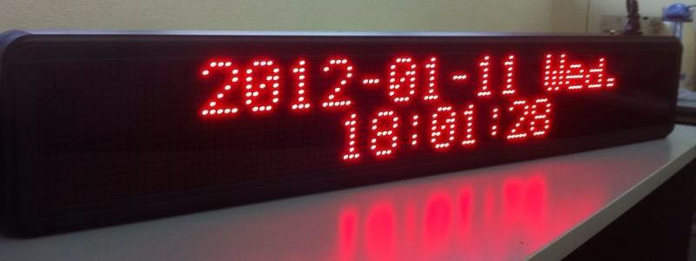
LED: Light emitting diode - Applications
As indicators and light source in fiber optics communication.
A number of LED'S may be grouped together to form a display

Slide 25
Semiconductor LASER
Semiconductor lasers are of two types. Except the Construction, Principle and working are same for both.
1. Homojunction semiconductor Laser
2. Hetrojunction semiconductor Laser
A homojunction uses the same semiconductor material (with different doping) on both sides of the junction, a heterojunction uses two semiconductor materials having different band gap energies on both sides of the junction.

Slide 26
Semiconductor LASER
Principle:
In conventional lasers(Ruby, Helium-Neon), laser light are generated due to transition of electrons from higher to lower energy level.
But in semi-conductor lasers the transition takes place from conduction band to valence band.
Laser light is produced due to recombination of electrons and holes at pn-junction when current is passed through the diode.
Laser light is due to stimulated emission.
When current is passed through pn junction under forward bias, the injected electrons and holes will increase the density of electrons in CB and holes in VB.
As the current is further increased at some threshold value of current the amplification will takes place and laser begin to emit coherent radiation.
The properties of semi conductor laser depend upon the energy gap.

Slide 27
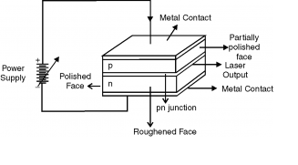
Semiconductor LASER
Construction

Slide 28
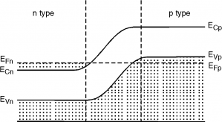
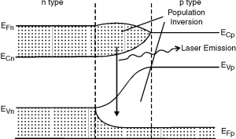
Semiconductor LASER
No biasing
Forward biased

Slide 29
Semiconductor LASER
Working
When the junction is forward biased, electrons from n-region & holes from p-region move to cross the junction in opposite directions.
In the junction region the electrons &holes recombination due to transition of electrons from CB to VB.
For low currents population inversion does not take place, hence only spontaneous emission takes place and the photons released are not coherent.
When forward current is further increased beyond the certain threshold value, population inversion takes place and coherent photons are released.
The energy gap of Gallium Arsenide (Ga-As) is 1.487eV and corresponding wavelength of radiation is 6435 A⁰ which is responsible for laser emission.

Slide 30
Semiconductor LASER
Characteristics
Applications
Directionality
Negligible divergence
High intensity
High degree of coherence
Monochromatic
Communication
Medical
Industry
Chemical
Biological

Slide 31
LED and Semiconductor LASER
Parameter | LED | LASER
Material | pn junction(FB) | pn junction(FB)
Biasing | Forward biased | Forward biased
Principle | Spontaneous emission | Stimulated emission
Coherence | Incoherent | Coherent
Directionality | Non-directional | Directional

Slide 32
Internal photoelectric effect
When light is incident on an intrinsic semiconductor, electrons are excited from valence band to conduction band and this leads to generation of electron and hole. Thus an increase of charge carrier concentration occurs within the semiconductor and the effect is called internal photoelectric effect.

Slide 33
Photoconductive effect
Photoconductive effect: An increase in free charge carriers leads to an increase in the conductivity of the semiconductor. The light induced increase in the electrical conductivity is called photoconductive effect or photoconductivity.

Slide 34
Photo detectors
These are devices that absorb optical energy and convert it to electrical energy. The operation of photoelectric detectors is based on internal photoelectric effect.
It is a p-n junction diode which is reverse biased.
When a photon is incident on the junction, a electron - hole pair may be generated in the depletion region. The electric field due to the immobile ions in the depletion region will separate the electron and holes that are generated.

Slide 35
Photo detectors
The charge separation in Photo detectors may be used in two ways:
Photoconductive mode and 2. Photovoltaic mode.
Photoconductive mode:
The device which is reversed biased is left on short circuit externally. The diode is reversed biased and dark currents flow(current due to minority charge carriers). The reverse voltage application will increase the depletion layer’s width.
Photovoltaic mode:
If the diode is left on open-circuit, an externally measurable voltage appears between p and n regions. The diode is not biased and hence dark current does not flow. This mode of operation is used in solar cells.
Photo detectors are of two types: PIN and Avalanche detector.

Slide 36
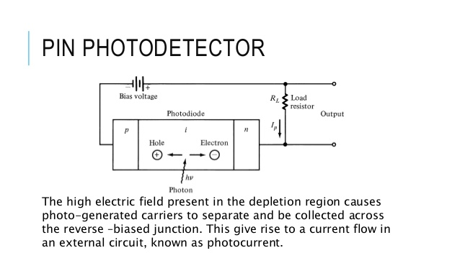
PIN Photodetector

Slide 37
PIN Photodetector
It is a device that consists of p region and n region separated by a very lightly doped intrinsic region (i).
The entire intrinsic region acts as depletion region.
The p-i-n structure of the photodiode enables to increase the width of the depletion region to a value which is greater than a p-n junction.
The p-i-n photodiode is reverse biased.
When a photon having energy greater than or equal to band gap energy is incident on the depletion region, then electron-hole pairs are generated.

Slide 38
PIN Photodetector
The high electric field present in the depletion region cause the electron-hole pair generated by the photon to separate and be collected across the reverse biased junction. This gives rise to a current flow in the external circuit.
As the depletion region is wide, most of the incident photons are absorbed in this region and the efficiency of the device is high.
Dark current is small. Dark currents are the current generated by minority charge carriers when no photons are incident on the material.

Slide 39
Characteristics of PIN Photodetector
V – I Characteristics:
Photodiode operates in reverse bias mode.
The photocurrent is nearly independent of reverse bias voltage which is applied.
For zero luminance, the photocurrent is almost zero but a small amount of dark current is present.
As optical power rises the photo current also rises linearly.

Slide 40
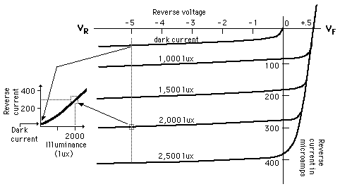
Characteristics of PIN Photodetector

Slide 41
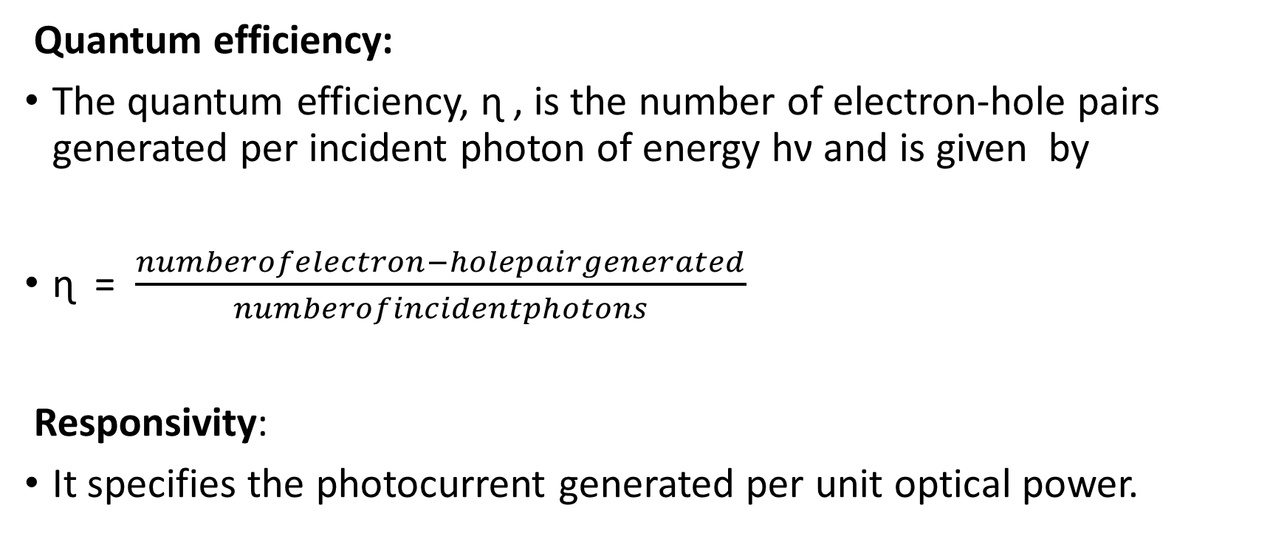
Characteristics of PIN Photodetector

Slide 42
Internal photoelectric effect
When light is incident on an intrinsic semiconductor, electrons are excited from valence band to conduction band and this leads to generation of electron and hole. Thus an increase of charge carrier concentration occurs within the semiconductor and the effect is called internal photoelectric effect.

Slide 43
Avalanche detector
Photoelectric current is amplified within the detector. It is very useful when low levels of light are to be detected.
The structure is known as p⁺ π p n⁺ structure. The π region is the intrinsic region.
The device is a reverse biased p-n junction. The p⁺ and n⁺ are heavily doped semiconductors and have a very low resistance.
The π region is very lightly doped and is nearly intrinsic in nature.

Slide 44
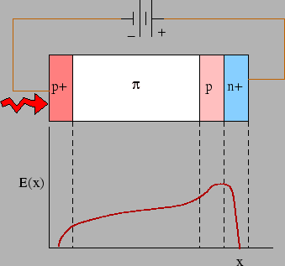
Avalanche detector
Under reverse biased condition a depletion region is present between p and n⁺ region and it covers most of the π region.
Under sufficient reverse bias, the junction approaches breakdown condition.
A electric field is present in the junction region due to immobile charge carriers.

Slide 45
Avalanche detector
A photon that enters through the p⁺ region is absorbed in the intrinsic region and the resulting electron-hole pair that is generated is separated by the electric field in the π region.
The hole drifts towards the p⁺ region and do not take part in multiplication process. The electrons drift through the π region to the p n⁺ junction.

Slide 46
Avalanche detector
The electric field present in the p n⁺ region accelerates the electrons which in turn ionize neutral atoms in its path.
The effect is cumulative and builds up into an avalanche. Thus there is carrier multiplication and internal amplification. This amplification process enhances the responsivity of the detector.

Slide 47
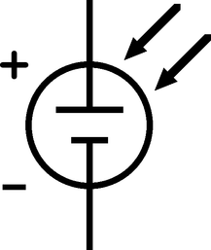
Solar cell
A solar cell is a p-n junction that can generate electrical power when illuminated with sunlight.
They operate under photovoltaic mode i.e. if the diode is left on open-circuit; an externally measurable voltage appears between p and n regions.

Slide 48
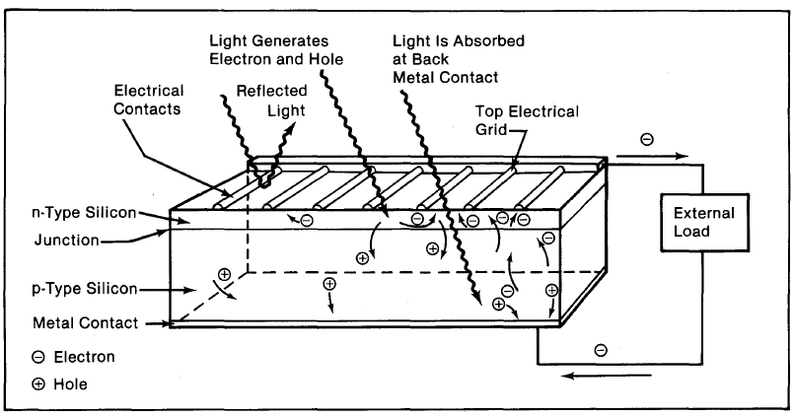
Solar cell

Slide 49
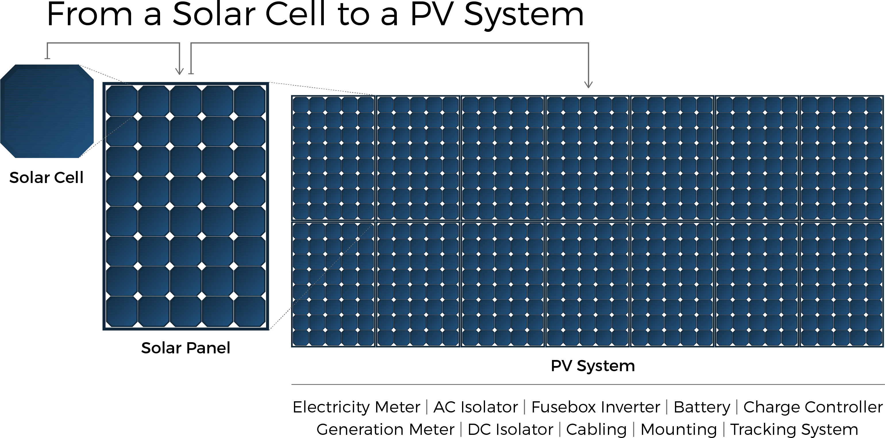
Solar cell – PV(Photovoltaic)system

Slide 50
Solar Cell
It consists of a p type chip on which a thin layer of n type material is grown.
The n region is heavily doped and thin so that the light can penetrate through it easily.
The p region is lightly doped so that most of the depletion region lies in the p side.

Slide 51
Solar Cell
It also consists of a glass cover and antireflection coating.
The front and back contacts are metallic contacts for the flow of electrons.
Electron hole pairs are mainly created in the depletion region and due to the built-in potential and electric field, electrons move to the n region and the holes to the p region.

Slide 52
Solar Cell
The movement of electrons and holes results in accumulation of charge on the two sides of the junction and produces a potential difference called photo emf.
If a load ( eg.-bulb) is connected across the cell a current flows through it.

Slide 53
Solar cell: I-V Characteristics
The I-V characteristics depend on the intensity of the incident radiation and also the operating point (external load) of the cell.
If the external circuit is a short circuit (external load resistance is zero) then the only current is due to the generated electron – hole pair by the incident light. This is called the photocurrent, denoted by I_{ph}. Another name for this is the short circuit current, I_{sc}.
The photo current is related to the intensity of the incident radiation, I_{op}, by I_{ph} = k I_{op} where k is equivalent to an efficiency metric that measures the conversion of light into electron-hole pairs.

Slide 54
Solar cell: I-V Characteristics
When external load, R, is connected it develops a voltage. This voltage opposes the built in potential and reduces the barrier for carrier injection across the junction.
This is similar to a pn junction in forward bias.
This forward bias current opposes the photo current generated within the device due to the solar radiation.
This is because I_{ph} is generated due to electrons going to the n side and holes to the p side due to the electric field within the device, i.e. drift current.
The forward bias current( due to external load) is due to diffusion current (I_{d}) i.e. electrons going to the p side and holes to the n side.
The net current can be written as I = −I_{ph} + I_{d}

Slide 55
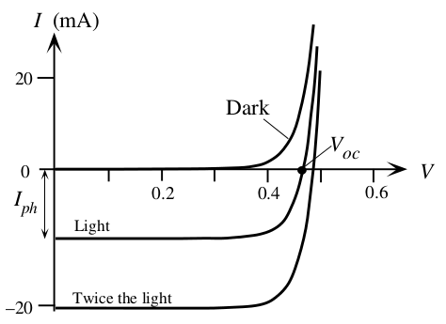
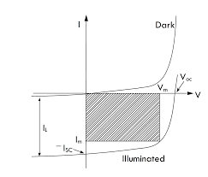
Solar cell: I-V Characteristics
Useful Power(P_{max} ) = V_{m} x I_{m}
Ideal power = V_{oc} x I_{sc}
Fill factor = useful power/ideal power
Fill factor is about 0.65 to 0.8 approx.
Dark current is the current due to minority charge carriers

Slide 56
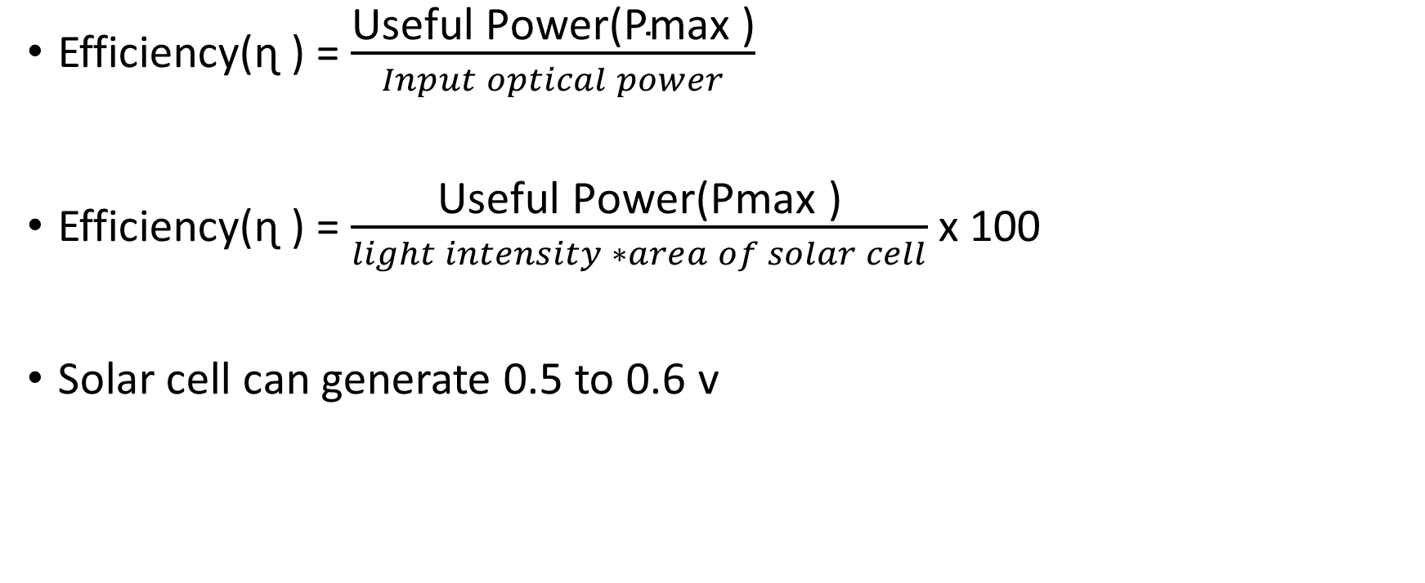
Solar cell: Efficiency

